Slide 1
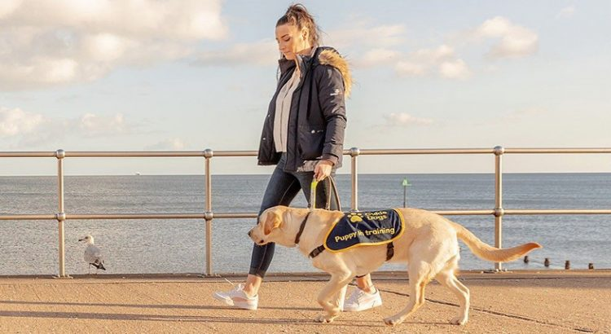
RECOGNISING
ASSISTANCE DOGS
MAKING THE
EXTRAORDINARY HAPPEN
Freedom to work.
Student Support and Wellbeing

Slide 2
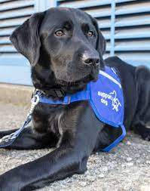
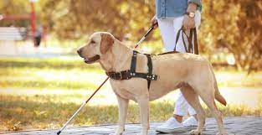
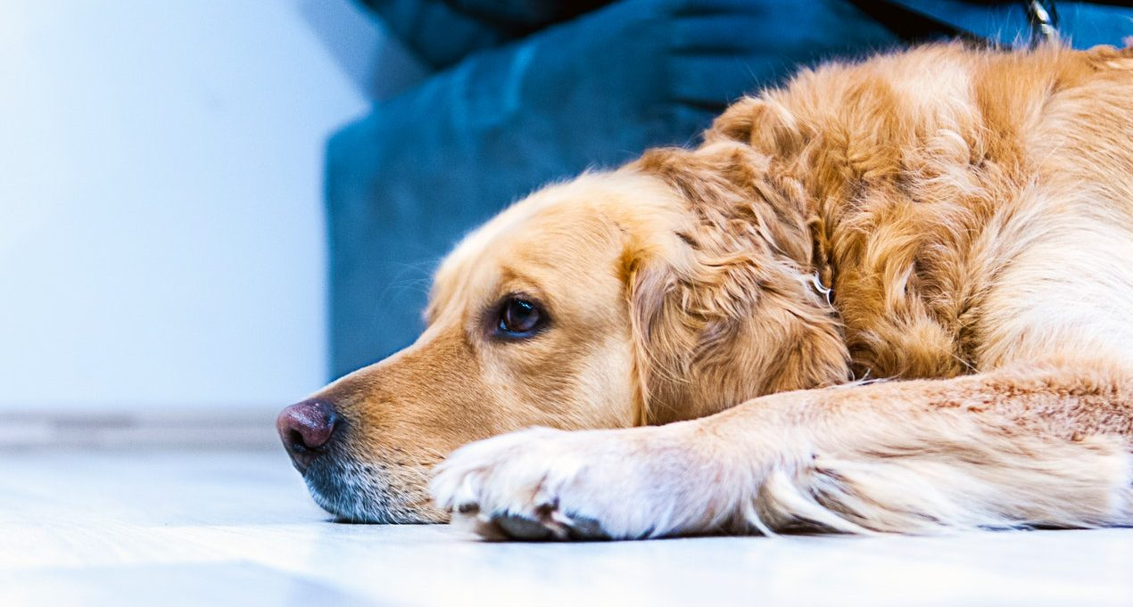
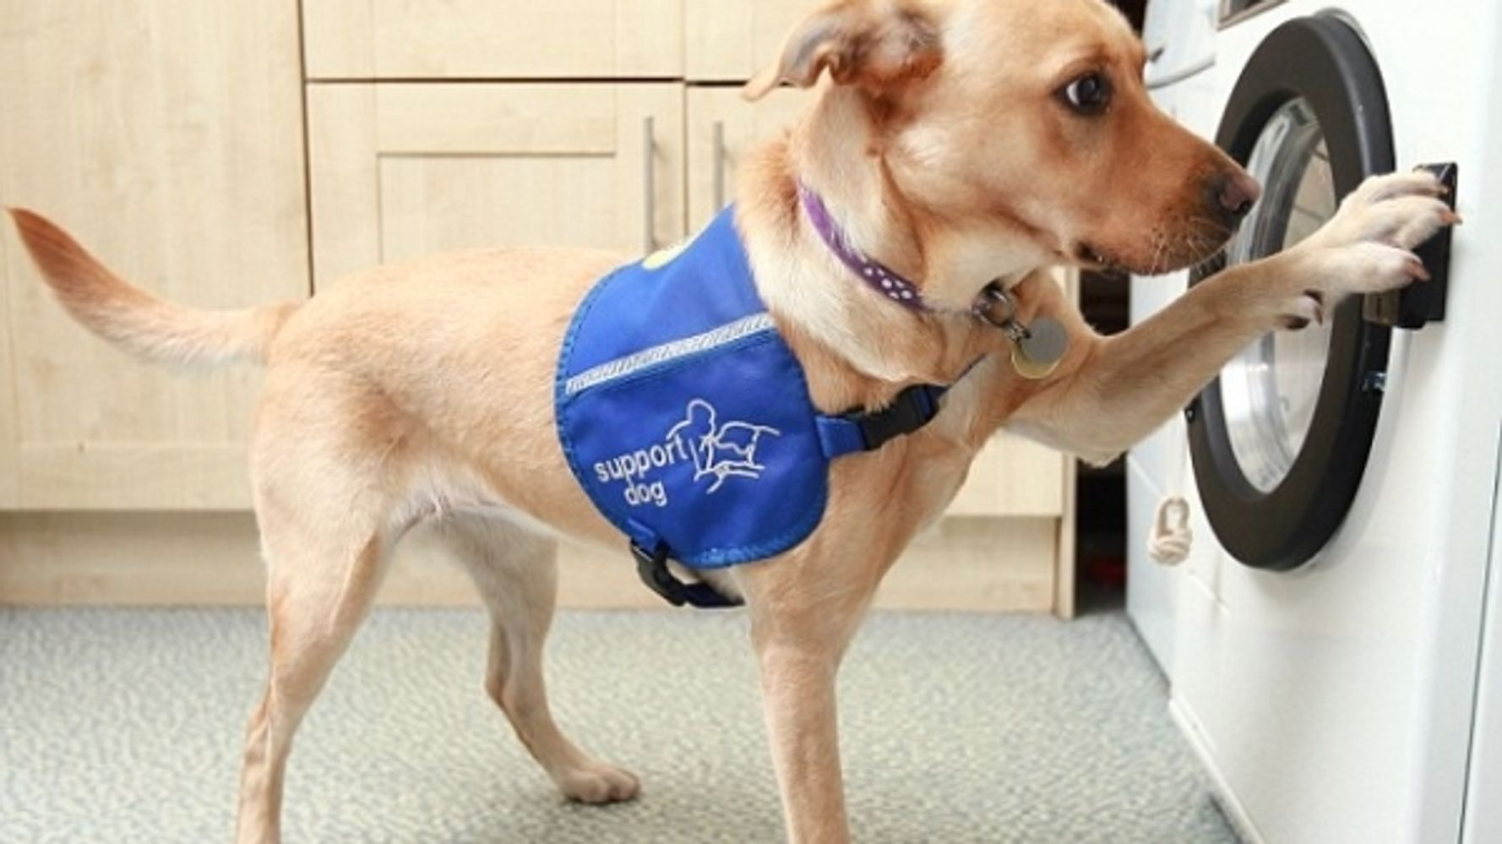
WHAT IS AN ASSISTANCE DOG?
Recognising Assistance Dogs
An Assistance Dog is a dog that has been trained in order to provide assistance to disabled people or those with a certain medical condition.
Assistance Dogs are permitted by law to accompany their disabled owner in all public places. This is supported by the Equality Act 2010.
Assistance Dogs are identifiable by a special dog jacket or harness. They will also wear an ID tag on their collar.
Bangor University’s policy is that Assistance Dogs accompanying a student to university will be allowed into University buildings and facilities, including all teaching spaces.

Slide 3
WHAT TO DO WHEN AN ASSISTANCE DOG IS PRESENT?
Recognising Assistance Dogs
Always show the dog and their owner respect by providing space and giving them the right of way.
Don’t touch, feed, talk to, or otherwise distract the dog and don’t be offended if the owner asks you not to pet the dog. The dog should be allowed to concentrate and perform its work for the safety of its handler.
Recognise that the dog has a right to be present everywhere on campus, even where you would not expect to see a dog, such as in a lift.
If you are unfamiliar with dogs, be assured that an Assistance Dog presents no threat to you, or other students. They are highly trained, working dogs.
Assistance Dogs are highly respected in the UK.

Slide 4
SHOWING AN ASSISTANCE DOG PROPER RESPECT
Recognising Assistance Dogs
Failing to respect an Assistance Dog would be considered to be an infringement of the University’s rules and regulations.
Confronting an Assistance Dog’s owner about the presence of their dog or making derogatory comments about the dog could be considered harassment.
Infringements of our rules and regulations, including harassment of an Assistance Dog or their owner could lead to the University taking action under its disciplinary procedures.

