Slide 1


WELCOME 2024/25
Student Health & Safety Information
N.B. ALL NEW STUDENTS ARE REQUIRED TO READ THE INFORMATION IN THIS PRESENTATION AND CONFIRM AT THE END THAT THEY HAVE DONE SO.​

Slide 2
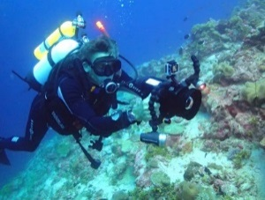

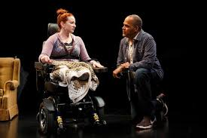

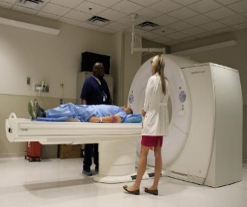

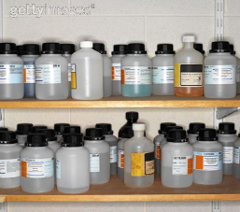


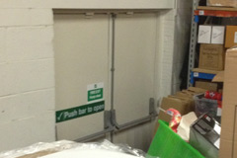




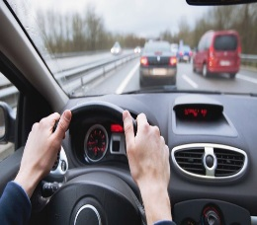
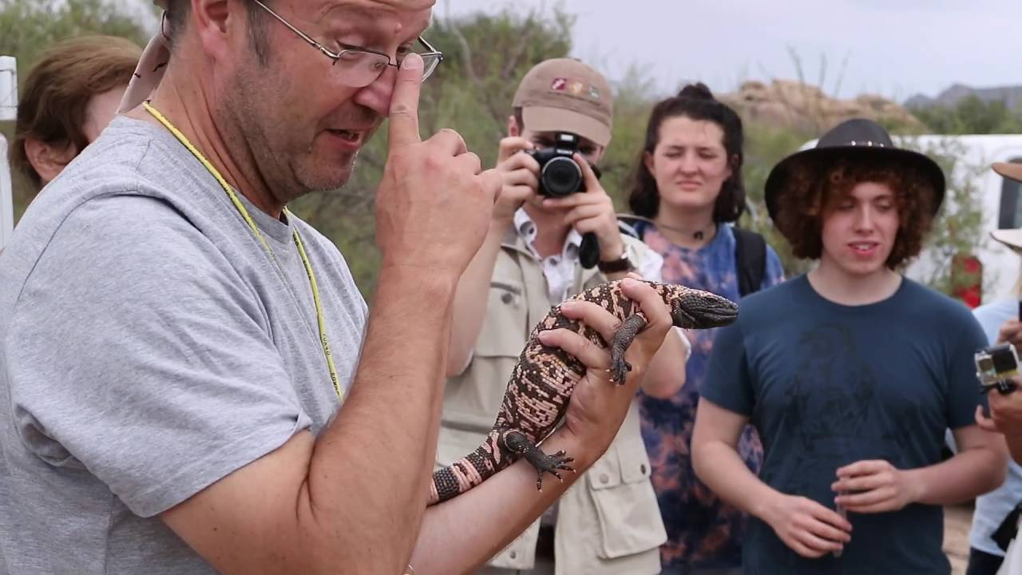

This University is an amazing place with so much usually going on…
Health and Safety
INTRODUCTION

Slide 3
Health and Safety at Bangor
Bangor University has unequivocal duties under health and safety law for the health, safety and welfare of its students, staff and visitors.

Slide 4
Your Health & Safety Responsibilities
To support us we ask that you:
Don’t do anything that puts your or other’s health and safety at risk
Cooperate with others so they can carry out their own health and safety duties
Follow health and safety instructions, information and training
Never intentionally misuse anything provided for health and safety reasons
Bring any health and safety concerns to the attention of your Lecturer and/or your Placement Tutor
Report all accidents and incidents to your Lecturer or Placement Tutor

Slide 5
What you can expect from your College
Your College will:
Provide appropriate information, instruction, training and supervision to ensure your health and safety
Assess risks that could arise during your studies
Put in place suitable health and safety measures to protect against these
Record significant findings - ‘Risk Assessments’
Tell you about Risk Assessments that are relevant to you
Inform you of any changes, updates etc

Slide 6
Health and safety is usually just common-sense
Be practical:
Think about what you want to do
Where is are you doing it e.g. inside, outside
Consider who you are with, or who else could be affected by what you are doing
If needed, check you have the right things for the task: equipment, clothes, food and drink…
Make sure you carry out the activity safely so no one is harmed by what you are doing
Follow any instruction or training you have been given
AND IF IN DOUBT PLEASE ASK

Slide 7

University Non-Smoking Policy
There is a strict Non-Smoking Policy inside all University buildings
On University land, smoking is prohibited within 5m of any building, with the exception of agreed ‘designated smoking areas’
The ‘designated smoking area’ for the Main University Building is: Under the Archway leading to the Main Quad and beside the Lloyd Building near the Terrace
The above also includes the use of e-cigarettes

Slide 8


Fire – Emergency Action
If you start or discover a fire:
    Raise the alarm by activating a manual
    Call Point
    DO NOT stop to put out the fire
Call Point
    Leave by the nearest, safest exit
    If possible close doors as you leave
    Go to the Assembly Point

Slide 9


Fire – Emergency Action
If you hear a fire alarm - DO:
    Stop work immediately
    Leave by the nearest, safest exit
    Close doors as you leave
    Go to the Assembly Point

Slide 10


Fire – Emergency Action
If you hear a fire alarm – DO NOT:
    DO NOT use lifts
Take personal belongings, carry hot drinks etc
Re-enter buildings until instructed by Security staff
If you cannot evacuate via the stairs go to a Refuge Point
Visit the Disability Services Website for further information
Stand too close to the building or obstruct routes
Leave the Assembly Point

Slide 11

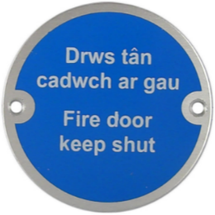
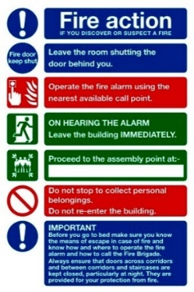
Fire Prevention / Precaution
Refuge Point: Includes operation details
Learn about:
Building layout
Fire Exit routes
Call Point locations
Emergency phones
Refuge Points
Fire Action Notices
Assembly Points
Fire Exit Signs: Direct how to quickly leave a building
Mandatory Signs: Means you must do what it says
Fire Action Notices:
Displayed in all Buildings. They provide general fire safety information
Assembly Point: Where to wait safely after leaving a building

Slide 12
Refuge Points
If you cannot evacuate the building via stairs you should have a Personal Emergency Evacuation Plan (PEEP) (arranged through Disability Services) that advises about Safe Refuge Points and their emergency communication facility.
If the alarm sounds go to a Refuge Point and activate.
Most systems link to Security via an intercom. When Security answer, tell them where you are and await instructions.

Slide 13

In Case of Emergency
Emergency Telephone Numbers
Ring Security on 333 (internal telephone and on TEAMS) for First Aid Assistance, Ambulance, Fire, Police
Or call Security staff on:
  01248 38 2795
  01248 38 3472
  01248 38 8041
If Security staff are not available ring 999/112 for the Police, Ambulance or Fire & Rescue Service
Look for First Aid Posters in buildings which will detail local First Aid arrangements

Slide 14
Accident & Incident Reporting
Please report to us:
Any accident resulting in illness, injury or damage
Any incident that may have resulted in illness, injury or damage
Any incident that involves crime

Slide 15
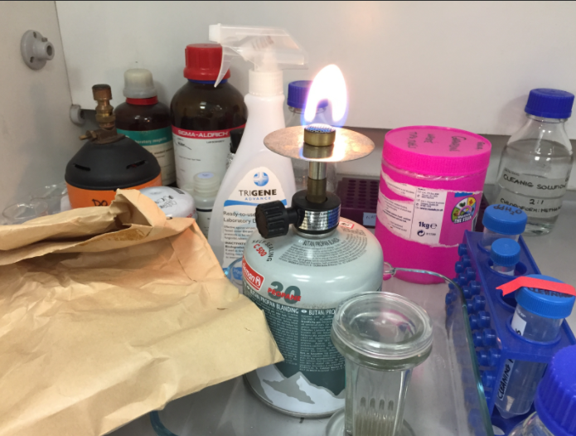
Hints and Tips
Good housekeeping
  Keep your work areas clean / tidy
  Dispose of rubbish promptly
Electrical
  Do not overload electrical sockets
  Be careful of trailing cables
  Do not cover electric heaters
Slips, Trips and Falls
  Report problems promptly e.g. damaged floor, ice on steps
Moving, lifting and handling
  Never struggle, ask for help
Never overload sockets.
Be mindful of cables
Don’t use walkways,
door ways, fire escapes
for storage
Good housekeeping. Keep work areas clean & tidy. Work safely

Slide 16
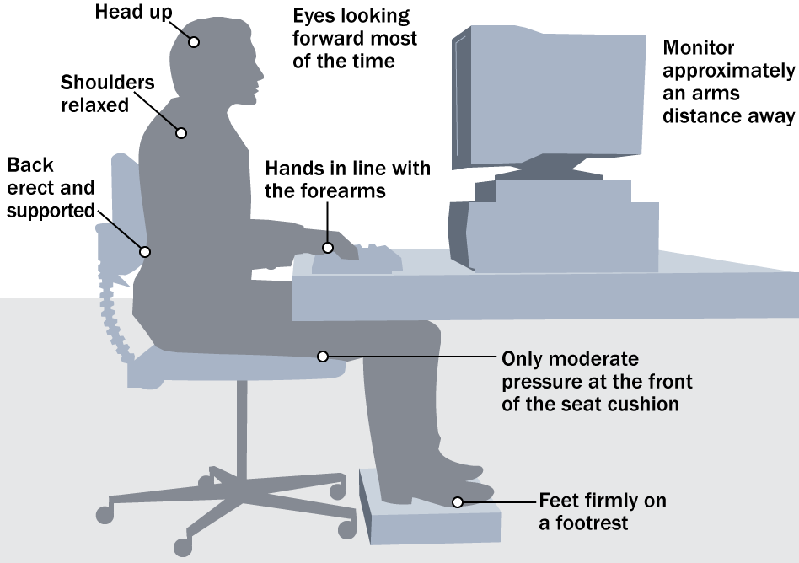
Are you sitting comfortably?
Using Display Screen Equipment:
Work station set up
Correct posture
Make sure you take regular breaks
It isn’t just about computers, what about your phone, iPad, tablets…
Click here for Student DSE Advice - Student DSE Advice
A good layout

Slide 17
Student Health & Safety Handbook
All students should familiarise themselves with the Student Health and Safety Handbook:
The Handbook and a range of other useful information is available at:
www.bangor.ac.uk/hss/students/students.php.en

Slide 18
Covid-19 and other Communicable Diseases
Some of the things we did to protect ourselves and others against Covid-19 also help to reduce the risk of exposure to other communicable diseases.
You will still find ‘lessons learnt’ in place across the University. Lecture rooms are better ventilated and there’s more space.
We are all generally more aware of how infections can spread. If you wish, please feel free to continue wearing a face covering in lectures, computer rooms etc.
If you feel unwell and suspect you may have Covid-19 please do not attend lectures or mix with others, isolate yourselves and look after yourself and others.
Student Services offers help and information on all manner of other communicable diseases, including measles and Monkeypox, and how to register with a local doctor.

Slide 19



Sustainability and the Environment
The University has an Environmental Management System (EMS) accredited to the ISO14001:2015 Standard - at it’s core is the Environmental Policy
Look out for campaigns and posters on how you can get involved with recycling, beach cleans and saving energy.
Click on the link to visit the Bangor Sustainability page- www.bangor.ac.uk/sustainability
Click on the link to visit the Bangor environment page www.bangor.ac.uk/environment

Slide 20

Almost the last word…!
“If it looks or feels unsafe, it probably is.
So please tell us about it”

Slide 21
Useful Links
Click on the link to visit the Bangor Colleges page –Bangor Colleges
Click on the link to visit the Bangor the Bangor Student Services page - Bangor Student Services
Click on the link to visit the Bangor to visit the Bangor health and safety page - Bangor Health and Safety
Click on the link to visit the Bangor to visit the Bangor students Union Page - Bangor Students’ Union
Click on the link to visit the Bangor to visit the Bangor sustainability page - Bangor Sustainability

Slide 22
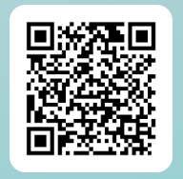
THANK YOU FOR TAKING THE TIME TO READ THIS PRESENTATION.
Now please complete our form via this link to confirm you have done so (response rates are monitored).
Good luck with your studies!

